Slide 1
Metallisation

Slide 2
Outline
Introduction
Applications of a metal
  Gate
  Interconnect
  Contacts
Metal Deposition

Slide 3
Properties of a Metal
Low Resistance
Good adhesion
Make good contacts
Thermal stability
Reliable over time

Slide 4
Metal Resistivity (μΩ.cm)
Cu 1.7- 2.0
Al 2.7 - 3.0
W 8 - 15
Ti 40 - 70
TiSi₂ 13 - 16
CoSi₂ 15 - 20
Poly 450 - 1000

Slide 5
Main Applications of metal
Gate - used to control the devices
Interconnect - used to connect up the devices
Contact - make contact to the device
Contact Holes
Interconnect
Gate
N+
N+

Slide 6
Application 1 : Gate Metal
Originally one layer of metal performed all three functions
However a metal gate is not suitable for complex designs due to design limitations, temperature restrictions and interactions between the metal and the underlying gate oxide
Doped polysilicon is the most commonly used gate material (and first layer of interconnect)

Slide 7
Polysilicon as a gate material
Plan View
Active
Area
Thick
(Thin Ox)
Field
Oxide
Source
Drain
Poly
Cross section
Poly
N +
N +

Slide 8
Application 2 : Interconnect metal
Metal
Deposited
Oxide
Polysilicon
Thermal Oxide
Low resistance metal connects up the devices
Polysilicon gate is isolated from the metal interconnect by oxide layers
As the circuit becomes more complex single level metal is not sufficient and two to four layers of metal can be used

Slide 9
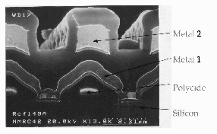
Double Level Metallization

Slide 10
Interconnect Problem 1
Step Coverage
Metal
Oxide
Polysilicon
If the dielectric is conformal then it may be difficult for the metal to remain continuous over sharp edges
The dielectric should be planarised to ensure good metal step coverage

Slide 11
Definition of step coverage
B
A
Step Coverage % = B/A Example : 0.5µm/1.0µm = 50%

Slide 12
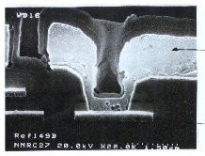
Single Level Metallization
Metal
Polycide

Slide 13
Planarisation
Metal 2
Interlevel
Metal 1
Dielectric
Unplanarized Double Level Metal Scheme
Planarized Metalization Scheme

Slide 14
Planarisation Techniques
High Temperature
  Reflow
Low Temperature
  Spin On Glass
  Resist Etch Back
  Chemical Mechanical Polishing

Slide 15
Reflow
High Temperature anneal of doped oxide
After Reflow

Slide 16
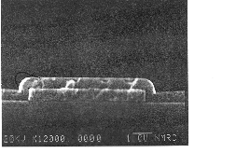

Slide 17
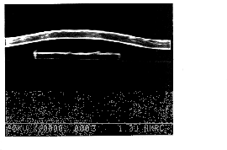

Slide 18
Spin On Glass (S.O.G.)
Deposit Oxide
Spin on SOG
Etch back SOG

Slide 19
Chemical Mechanical Polishing
Wafer carrier
Slurry
Wafer
Polishing Pad
Polishing Table

Slide 20
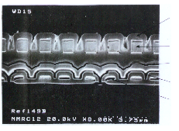
Interlevel Planarization
Passivation
Metal
Polysilicon
Polycide 2
Polycide 1

Slide 21
Interconnect Problem 2
Electromigration
Mass transport of the metal due to high current density in the metal
- ve
+ve
Jc

Slide 22
Application 3 : Metal in Contacts
Potential problems
  Step coverage
  Spiking
  Contact Resistance
Problem is worse as aspect ratio increases
  AR = Depth : Width
Contact

Slide 23
Contact Problem 1 :
Step Coverage into Contacts
It is difficult for the metal to remain continuous when it is deposited into small contact holes
Three main solutions
  Alter the shape of the contact
  Use another metal to fill the contact
  Change the deposition conditions

Slide 24
Step Coverage in to Contacts
1. Alter the shape of the contact
Anisotropic Etch
Tapered Etch
Champagne Etch
2. Use a contact fill
Example : CVD Tungsten

Slide 25
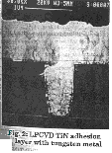

Slide 26
Contact Problem 2 - Spiking
Silicon dissolves in Al and the Al moves into the Si to fill up the void
Metal
Oxide
Diffusion
Metal Spike

Slide 27
Spiking Solutions
Add small amounts of Si to the Aluminium to prevent the Si being absorbed. (equilibrium at 2%)
Use a barrier to prevent the Aluminium / Si interaction
  TiW and TiN are the most common barriers used
Metal
Oxide
Barrier Metal

Slide 28
Contact Problem 3
Contact Resistance
The resistance between the metal and the Silicon must be kept as low as possible
This can be achieved by forming a silicide in the contact
Refractory metals are the most common metals used for silicide (eg: TiSi₂, CoSi₂)

Slide 29
Silicide formation in a contact
Deposit metal eg: Titanium
Low temperature anneal
  Ti reacts with Si not SiO₂
Remove unreacted Ti and anneal to form stable TiSi₂

Slide 30
Silicide in a transistor
Contact Holes
Interconnect
Gate
N+
N+
Barrier
Silicide

Slide 31
Metal Deposition
The most common deposition technique is sputtering down to about the 180nm node
After the 180nm node a copper damascene process is used
Sputtering is a physical process that takes place in vacuum chamber
A vacuum of ~ 10-7T is achieved after the wafers are loaded (base pressure)
Argon gas is introduced to a pressure of ~ 10-3T
This pressure is maintained by balancing the gas inlet rate and the pumping rate

Slide 32
Sputtering Principle
Electrons leave the target and collide with the gas atoms
Positive ions are created
The gas ions are attracted back to the negative target where they collide with it
Metal atoms are knocked off the target and travel across to the wafer surface
Substrate
Anode
Anode
Ar
Ar+
e-
Metal atom
Target
Material
Cathode
-ve

Slide 33
FILM GROWTH
The first atoms act as nucleation sites on the surface
Subsequent atoms grow around them in cluster type formation until a continuous layer is formed

Slide 34
Magnetron Sputtering
There are two problems in a non-magnetron system
  (1) If electrons leaving the target reach the wafer the wafer can become very hot
  (2) A very large voltage must be applied to the target to ensure there are a sufficient number of electrons
Permanent magnets are placed behind the target and the magnetic field acts to keep the electrons close to the target surface

Slide 35
Magnetron Sputtering
N
S
N
DC Magnetron
Sputtering
e-
e-
Cathode
e-
e-
e-
e-
e-
e-
e-
e-
e-
e-

Slide 36
Damascene Metal Processing
Small geometry semiconductor manufacturers are moving away from Al/Si - SiO2 processes to Copper - Low k Dielectric processes
Copper is a difficult metal to etch - the process used to over come this difficulty is the “Damascene” process
In the process where the vias or contacts to the underlying transistors or another layer of metal are cut at the same time as the metal, it is known as “Dual Damascene”

Slide 37
Trench Cut in Dielectric Layer
2-D
3-D

Slide 38
Deposit Barrier/Seed Layer
These are usually two separate materials

Slide 39
Plate with Copper

Slide 40
CMP the Copper and the Barrier Layer

Slide 41
Exploded View
Copper Track
Dielectric
Barrier/Seed Metal

Slide 42
Dual Damascene
Tracks for second metal
layer are cut (etched) in
the dielectric

Slide 43
Dual Damescene Vias
Vias are then
opened down
to the first layer
of metal
The Dual process can be done as a “Via First” or as a “Trench First Process”

Slide 44
Dual Damascene Exploded View
The barrier/seed layer
is left out for the sake
of clarity

Slide 45
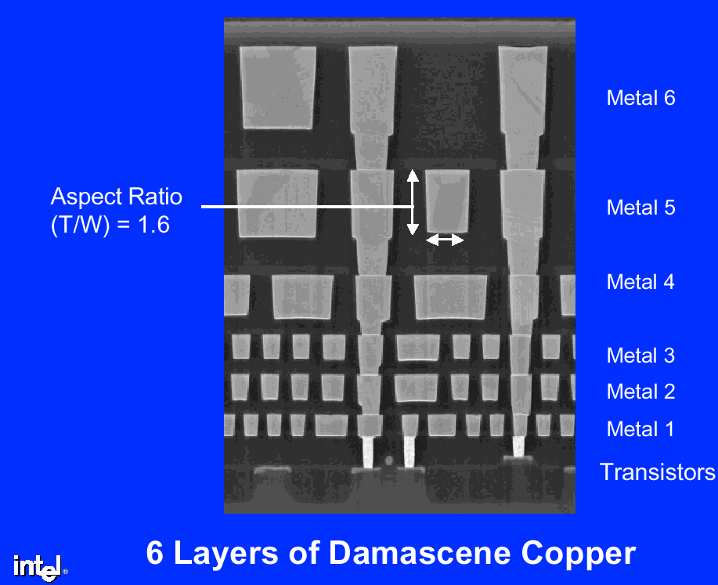

Slide 46
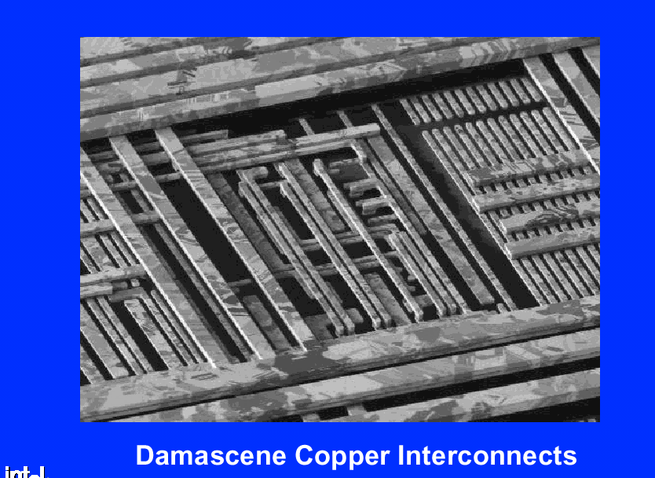

Slide 47
Interconnect Summary
Copper was introduced to MPUs at the 220nm node
For very high speed DRAMs Cu will also be used but in the main DRAM will not use Cu until the 100nm node
It is necessary to get beyond the 2.2μΩ-cm effective resistivity characteristic of barrier/Cu
Solutions <100nm
  Reduction of operating temperature to allow the use of super conducting material
  Optical interconnect

Slide 48
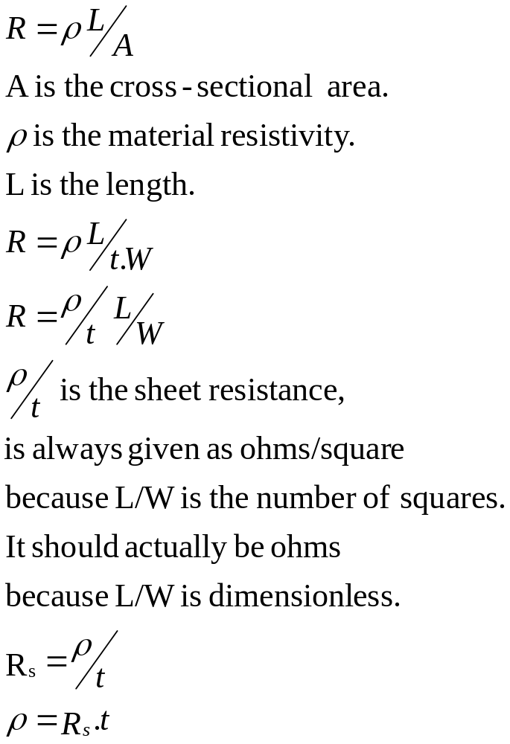
Sheet Resistance
L
t
W

